Slide 1
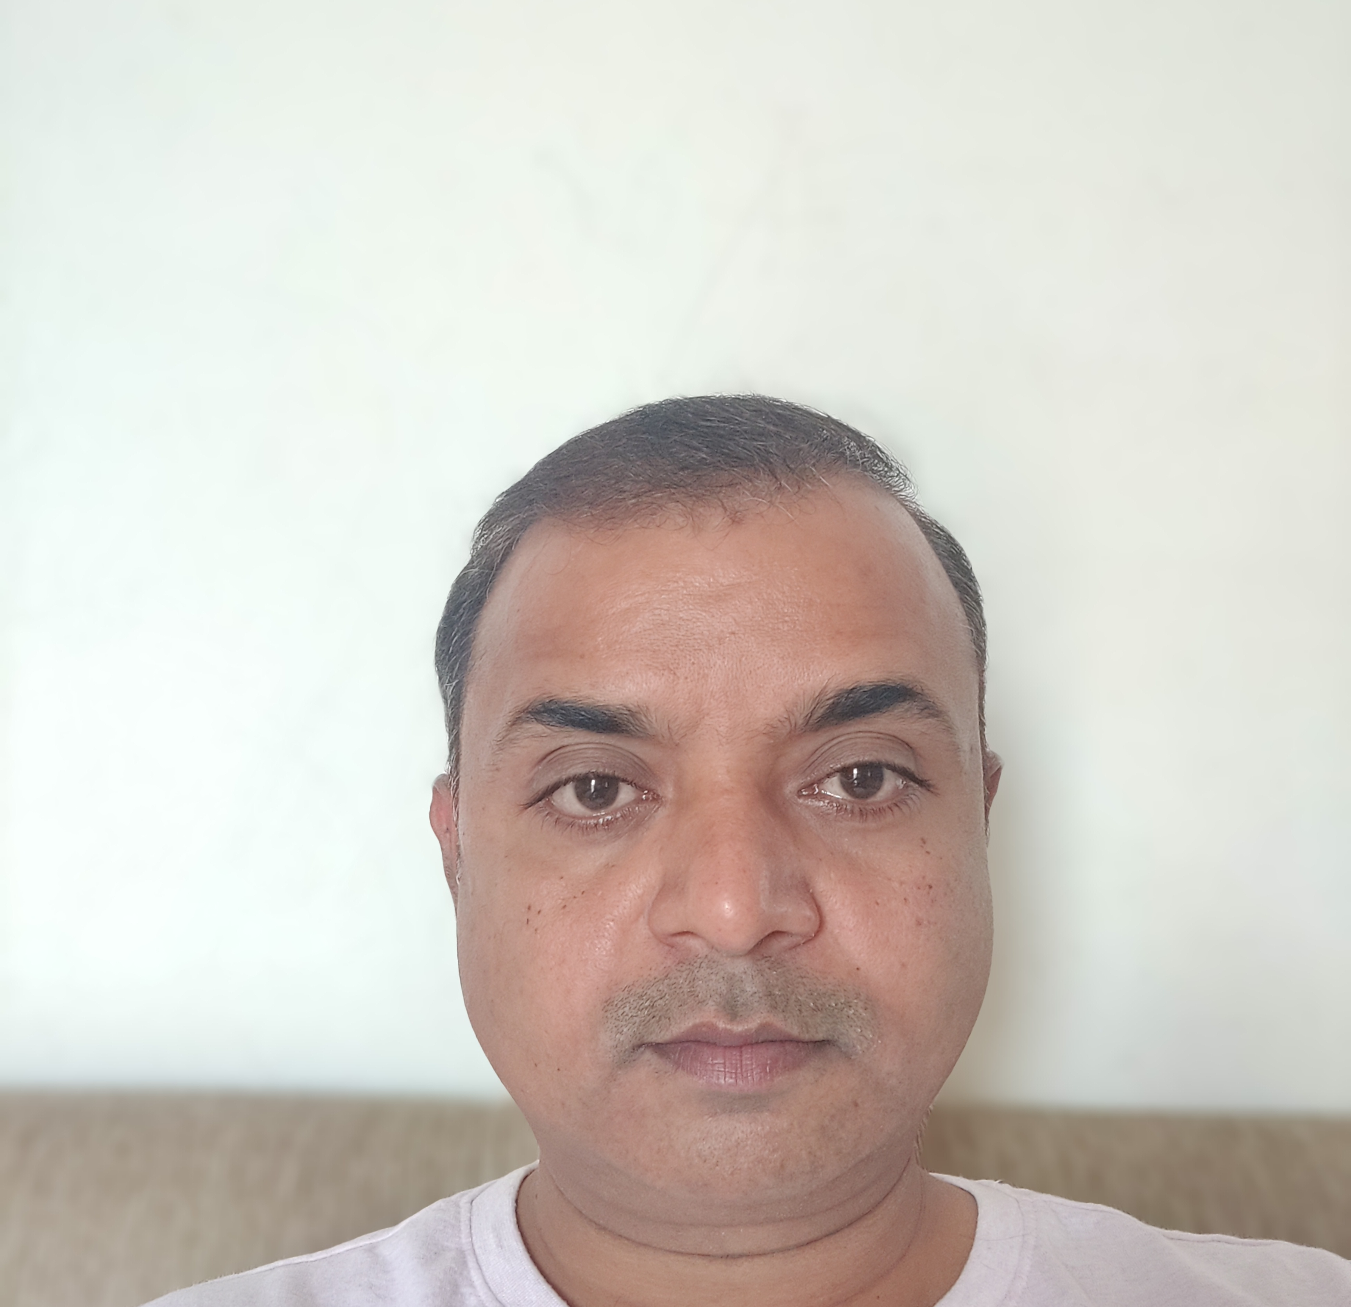
Roopesh Saxena | Technical Architect
Roopesh Saxena
Profile
Professional experience
Technical Architect
Roopesh is a seasoned technology leader with over 15 years of experience in software architecture, enterprise integration, and digital transformation. He specializes in Pega architecture, performance optimization, and AI-driven solutions across industries including finance, healthcare, and insurance.
15+ years of experience in enterprise software development and integration
Proven leadership in establishing Centers of Excellence and driving digital transformation
Expertise in Pega BPM, Gen AI, Agentic AI and cloud-native deployments
Strong background in performance tuning, architecture modeling, and Agile delivery
Delivered mission-critical solutions for clients including Standard Chartered Bank, ING, Morgan Stanley and Singapore Airlines Cargo.
Pega Lead System Architect | Singapore Airlines Cargo | 2025–2026
Reimagine application with Pega Blueprint
Voice AI implementation for inbound calls via Twilio
Gen AI rules for document extraction and risk analysis
Constellation based application development
Perm Bridge implementation for OnPrem applications
Pega Knowledge buddy for FAQs.
Chapter Lead | Standard Chartered Bank | 2022–2025
As chapter lead, led and managed multiple agile squad, ensuring alignment with business goals and technical standards.
Implemented Single Sign on using Microsoft ADFS
Upgrade from 7.2 to 8.5
Data Encryption and Data Extraction
Technical Lead | ING NL| 2019–2022
Pega DX API implementation for head less application.
Data security using Attribute based control.
Data Modelling for application
Pega Survey Framework for questionnaire
Technical Lead | Morgan Stanley | 2013–2019
Savion to Pega Migration
Situational Layer Cake for Pega Application
Integration with downstream system
Authentication and Authorization Model
Education & certifications
Bachelor of Science, Kanpur University
Certifications technical
PEGA Certified Lead System Architect
Pega Decisioning Consultant
Pega Certified Senior System Architect
Pega Certified System Architect
Competencies
Skillset:
Pega Infinity
Pega GenAI
Pega Agentic AI
Pega CDH
PEGA Constellation
React JS, Java and JavaScript

